Slide 1
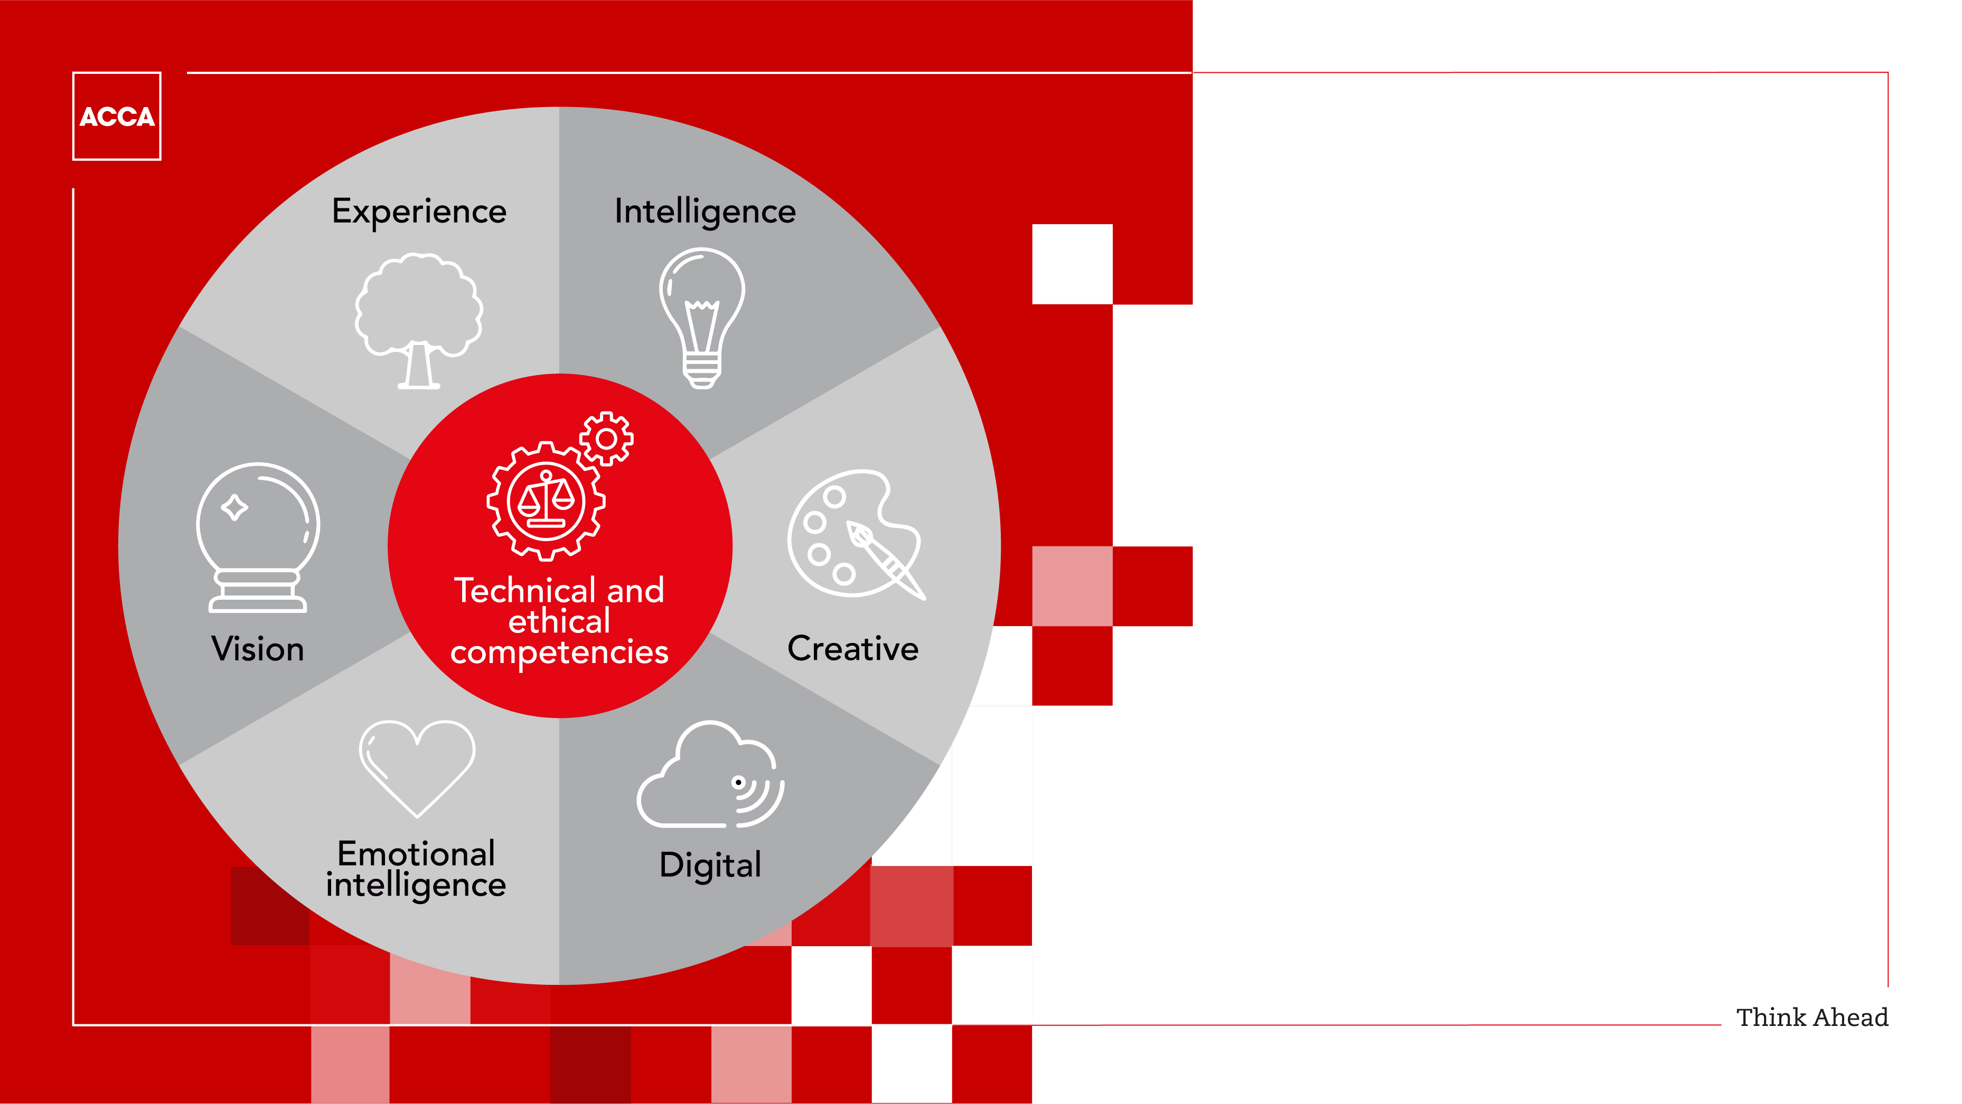
The seven quotients:
Equipping tomorrow’s accountants for success
© ACCA

Slide 2
Our profession is changing fast
1
2
Our profession is undergoing unprecedented change. It’s the result of many factors, but ground-breaking research conducted recently by ACCA together with its members, employers and partners
has identified the four key drivers:
Increased regulation and stronger governance
Advances In
digital technology
As well as challenges, change will
bring benefits:
Technology will enable near real-time reporting, support predictive vs retrospective analysis, and highlight links between financial and
non-financial factors.
It will also give accountants more time for
long-term strategic planning.
3
4
Higher expectations
of the
business value
Continued globalisation

Slide 3







Typical Skills
Seven quotients for
tomorrow’s world
Advances In digital technology
In the face of all this change, ACCA’s research highlighted seven professional competencies or quotients that tomorrow’s accountants will need to progress their careers and add most value for employers and clients.
These seven quotients are at the core of the evolved ACCA Qualification.
Along with ‘typical’ competencies, ACCA’s quotients include three ‘softer’ skills and interpersonal behaviours that will be increasingly called for in future.
Technical and
ethical
Intelligence
Digital
Experience
Soft Skills
Creative
Emotional intelligence
Vision

Slide 4





What’s the right mix?
10%
20%
The optimal mix of individual quotients will vary according to role, responsibilities, career stage and industry developments.
As an example, three ACCA members ranked the quotients for relevance to them.
Interestingly, while the mix varied, the three
respondents consistently ranked less typical quotients higher for giving their careers a competitive edge.
Technical and ethical, intelligence,
digital: ranked less important.
“These are basic skills every accountant should already have.”
Creative, experience, emotional intelligence, vision: ranked more important.
“These skills can set someone apart from
their colleagues.”
10%
Technical and ethical
Intelligence
Digital
10%
Vision
Accountant 1
Creativity
20%
Experience
15%
Emotional intelligence
15%
8%
11%
8%
20%
8%
8%
15%
25%
Accountant 2
Accountant 3
20%
20%
6%
20%
16%
15%
Notes:
Speakers notes:
To see the video in which ACCA members ranked the importance of the Quotients to themselves, watch the ‘Ranking Panel Discussion’ at https://www.youtube.com/watch?v=K4WpsFLv5vk&t=2s

Slide 5


The quotients defined:
technical skills and ethics quotient (TEQ)
The ability to: perform activities to a defined standard, while maintaining the highest standards of integrity, independence and professional scepticism.
The most basic and fundamental quotient.
Being technically fluent in their area of work is simply expected of all accountants.
So is practicing the highest professional ethical standards when dealing with clients and stakeholders.
Being relentlessly curious will drive accountants’ skills in all of these areas. People expect ethical and responsible accountancy now more than ever.
Notes:
Speaker’s Notes
Technical Skills
This area involves being able to:
Follow the principles, procedures, guidelines and codes of professional conduct and ethics provided by the relevant professional body, local regulators, and international standard setters, for auditors in the public and private sector
Be ethical, sceptical and challenging, but constructive
Ethics
This area involves being able to:
Use highest standard of professional and ethical judgement when engaging with stakeholders
Apply ethical and professional values and frameworks in the promotion of public value and the profession
What does ‘professional scepticism’ mean?
It’s defined as:
“An attitude that includes a questioning mind, being alert to conditions which may indicate possible misstatement due to error or fraud, and a critical assessment of evidence.”

Slide 6



The quotients defined:
intelligence quotient (IQ)
The ability to: acquire and use knowledge, thinking, reasoning, solving problems and the ability to understand and analyse situations that are complex and ambiguous.
IQ is another fundamental quotient. It’s largely about being able to identify a problem, seek out all the relevant information then come to a carefully considered solution.
IQ also involves curiosity - acquiring knowledge about your industry and also the wider world, then using professional scepticism to evaluate that knowledge and
its source.
Having a wide range of knowledge is invaluable in problem solving Intelligence increases constantly
as new skills are learned.
Notes:
Speaker’s notes
Intelligence Quotient encompasses three phases – acquiring knowledge, evaluating it and using it well for problem solving
Accountants acquiring knowledge should think critically about internally generated and externally sourced information, including that prepared by professional accountants.
They should also actively seek knowledge not only about the industry but about the world at large. Accountants should be prepared to reach out to colleagues for help if there is something they don’t know
Evaluating knowledge demands thinking about the accuracy of information rather than assuming everything you read is automatically correct
Problem solving includes applying a wide range of knowledge to the individual’s own context (ie. industry/sector/client).
Non-financial outcomes (such as satisfaction of stakeholders or reputation or organization) should be factored into every decision.
In ambiguous/complex situations it’s important not to rush to decisions - consider all the information

Slide 7


The quotients defined:
digital quotient (DQ)
The ability to: be aware and have knowledge of existing and emerging digital technologies, capabilities, practices, strategies and culture.
Digital competency is another fundamental quotient. An accountant must have a varied technological skill-set and be able to apply it to their business and industry sector.
Having awareness of new technologies like Automatic Intelligence systems, Cloud computing and Blockchain were particularly highlighted by the ACCA research as important for tomorrow’s accountants.
Businesses need people who are able to suggest
relevant solutions for current and emerging digital issues. As part of DQ, accountants need to know how to apply software to analyse, interpret and present financial and non-financial data faster and more frequently.
Notes:
Speaker’s notes
DQ involves learning how to use technology. Understanding how big data, Cloud, mobile, and smart software make possible new models for:
Business, funding, production and service delivery
New industry sectors, payments systems, outlets for company disclosures and new approaches to gathering and testing audit evidence

Slide 8


The quotients defined:
experience quotient (XQ)
The ability to: understand customer expectations, and apply skills to meet desired outcomes and to create value.
Accountants gain experience constantly through
real-world interactions on the job and also through the research they should always be undertaking on their own initiative.
Even newcomers or students can gain experience –
by researching customers, asking questions and just being relentlessly curious.
Getting experience sometimes means being prepared to speak up in the face of disapproval. Reflecting (constructively) on past mistakes is a great way to develop useful experience.
Notes:
Speaker’s notes
Experience is a matter of getting things done having seen and learned the reality of how things operate.
Developing the Experience Quotient involves three areas:
- Building knowledge - seeking new knowledge and expertise
- Building experience with clients. Accountants should foster rewarding relationships with clients, colleagues and stakeholders
- Gaining experience on the job. Accountants must not be afraid to speak up in the face of disapproval. They should reflect on past mistakes in order to learn from them
In supporting customers, accountants should think about improving long term needs, not just immediate needs.
Simply operating within appropriate legal and governance frameworks and codes of practice isn’t enough these days. Accountants and those they advise and support must also take into consideration the (sometimes conflicting) expectations of stakeholders.

Slide 9


The quotients defined:
creative quotient (CQ)
The ability to: use existing knowledge in a new situation, to make now connections of logic, explore potential outcomes and generate new ideas.
A ‘soft’ quotient, but one of the most important for staying on top of change and demonstrating a competitive edge. Creativity is taking existing knowledge and making new connections of logic that help solve problems and give a business a competitive advantage.
CQ requires stepping away from spreadsheets and thinking about strategies and business insights. Sharing ideas and welcoming constructive disagreements are important ingredients.
Accountants should practice problem-solving using a range of different ideas. Creativity isn’t inborn. It can be developed through practice, positive thinking, being prepared to speak up - and getting away from the desk.
Notes:
Speaker’s notes
Ways to help develop this Quotient include:
- Problem solving using a range of different ideas
- Welcoming disagreements with colleagues
Looking for opportunities to take risks, even when failure is possible
While creativity can definitely be developed, it isn’t something anyone can learn in a book. Creativity comes from working, making new thought connections and exercising judgement.

Slide 10


The quotients defined:
emotional intelligence quotient (EQ)
The ability to: identify your own emotions and those of others, harness and apply them to tasks, and regulate and manage them.
Another ‘soft’ skill, the emotional intelligence quotient covers both personal and interpersonal skills.
Interpersonal skills include being able to communicate financial information to non-financial stakeholders, and having the awareness to build and manage multicultural teams.
Personal skills involve being able to seek advice from others and being open to making mistakes rather than avoiding them for fear of failure.
The most important skills many accountants currently lack are communication skills. Many newly qualified accountants also lack the ‘people skills’ to deal constructively with confrontation.
Notes:
Speaker’s notes
Being able to ‘deal effectively with confrontation’ works both ways. Many accountants, especially those newly qualified, lack the confidence to make challenges when they’re necessary.
Emotional intelligence involves being self-aware enough to seek out advice from others (not just about work - even about mood/emotions) and learning from mistakes rather than avoiding them in the first place.
Accountancy is an interactive profession and improving an individual’s EQ will improve their relationships with clients and stakeholders. Being able to ‘put yourself in others’ shoes’ will improve the ability to tailor information in ways that resonate
with the needs of the audience.

Slide 11


The quotients defined:
vision quotient (VQ)
The ability to: anticipate future trends accurately by extrapolating existing trends and facts, and filling in gaps by thinking innovatively.
Vision is a ‘soft’ skill that involves having an analytical, forward-thinking view.
Vision skills include being able to anticipate how various pieces of information may change the business or industry as well as how emerging trends may help the business be at the forefront of change.
Vision means being able to understand the environment and issues that may affect it. Today, that might mean – having a grasp of the growing field of Islamic finance, Sharia compliance and Islamic capital markets. Vision is one of the most important skills future leaders need.
Notes:
Speaker’s notes
Being able to ‘deal effectively with confrontation’ works both ways. Many accountants, especially those newly qualified, lack the confidence to make challenges when they’re necessary.
Emotional intelligence involves being self-aware enough to seek out advice from others (not just about work - even about mood/emotions) and learning from mistakes rather than avoiding them in the first place.
Accountancy is an interactive profession and improving an individual’s EQ will improve their relationships with clients and stakeholders. Being able to ‘put yourself in others’ shoes’ will improve the ability to tailor information in ways that resonate
with the needs of the audience.

Slide 12

Looking to the future.
Leading the way.
Thanks for taking time to discover the seven
quotients that are equipping tomorrow’s ACCA
accountants for success.
Full detail about ACCA’s ground-breaking research,
deep-dive looks at the drivers of change and analysis of the implications for accountants is at ACCA’s website.
There are also interactive tests that provide a
hands-on experience. Students can see the
quotients in real-world contexts while
established members can identify
skills gaps that need professional
development.
Find out more here: accaglobal.com/tomorrow

Slide 13

Where to find out more…
See how we’re looking to the future, leading the way.
Working together, members, employers and partners around the world are helping to shape the profession and keep ACCA at the forefront of tomorrow’s challenges.
Find out more at accaglobal.com/tomorrow
Join our community of advocates who, formally and informally, promote and publicly support ACCA around the world. accaglobal.com/advocacy
Share this presentation with colleagues, and suggest they visit our website for more on how ACCA is looking to the future, and leading the way accaglobal.com/tomorrow
Notes:
Speaker’s notes
Being able to ‘deal effectively with confrontation’ works both ways. Many accountants, especially those newly qualified, lack the confidence to make challenges when they’re necessary.
Emotional intelligence involves being self-aware enough to seek out advice from others (not just about work - even about mood/emotions) and learning from mistakes rather than avoiding them in the first place.
Accountancy is an interactive profession and improving an individual’s EQ will improve their relationships with clients and stakeholders. Being able to ‘put yourself in others’ shoes’ will improve the ability to tailor information in ways that resonate
with the needs of the audience.

